Slide 1
IECRE Conformity Assessment System
Frank Ormel
Chair of IECRE-Wind

Slide 2

Agenda
What is IECRE
Goals
Organisation & membership
Quality Assurance
Implementation

Slide 3
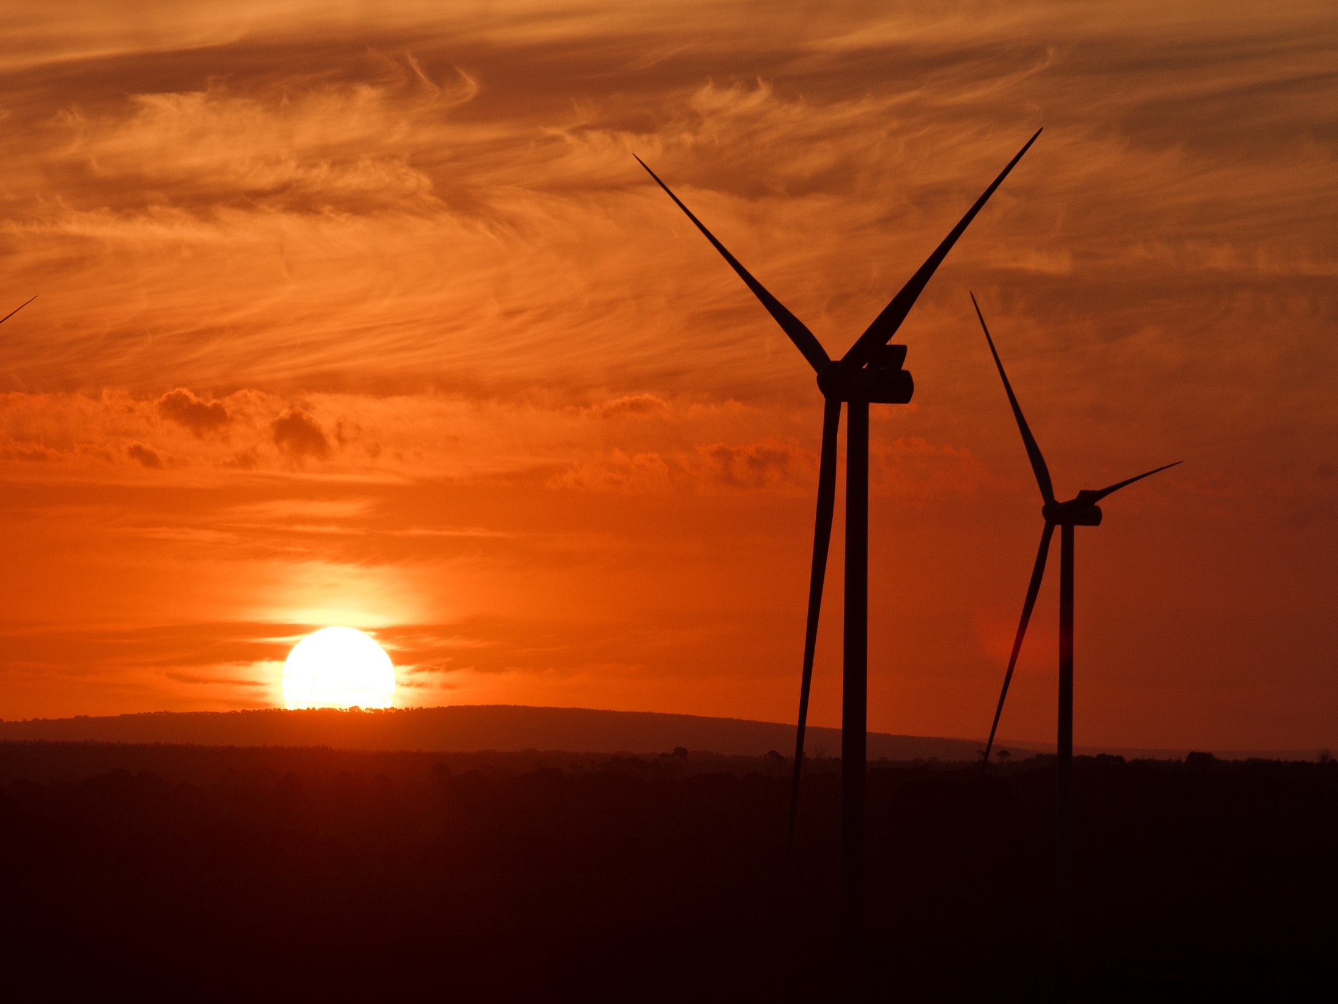
What is IECRE

Slide 4
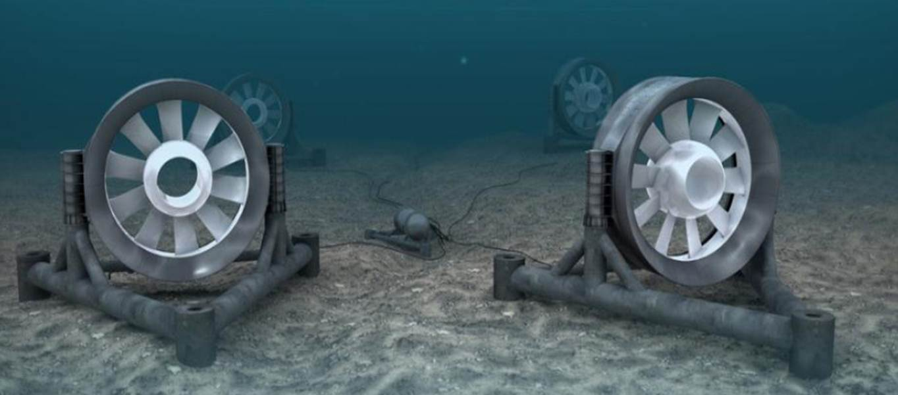
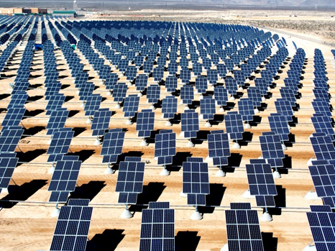
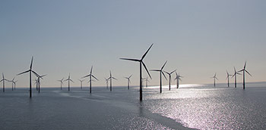
IECRE Sectors

Slide 5
IECRE
IEC Renewable Energy is a conformity assessment system under the IEC
IECRE secures the correct implementation and execution according to selected international standards
IECRE does not write standards, this is left to the various technical committees such as TC82 (Solar PV Energy), TC88 (Wind Energy) and TC114 (Marine Energy)
However, when standards are unclear these may be clarified under IECRE to ensure a uniform interpretation

Slide 6

IEC Structure
International
Electrotechnical
Committee (IEC)
Doctrine of separation of powers:
 | Govern-ment | Possible interpretation for the IEC
Make law/standards | Parliament | Technical Committees
Interpret law/standards | Court | Conformity Assessment system
Enforce law/standards | Police | Certification body
Standards Management Board (SMB)
Conformity Assessment Board (CAB)

Slide 7
Goals

Slide 8
IECRE Goals
The IECRE goal is to offer a harmonized application around the globe, which ensures a uniform:
implementation and mutual recognition between certification bodies and test labs
implementation and delivery of information by suppliers, sub-suppliers, end users and others providing documentation for certification
implementation and clear understanding of all suppliers, sub-suppliers, end users and other applicants for the elements and modules as well as reports, statements and certificates of the certification processes

Slide 9

Organisation

Slide 10
IECRE Structure
IEC CONFORMITY ASSESSMENT BOARD, CAB
Oversees IEC Conformity Assessment policy and Systems, eg IECEE, IECEx, IECQ, IECRE
IECRE Management Committee, REMC
Overall management of the IECRE System
IECRE Secretariat
National Members (Countries)
Technical Support
Officers + Executive, Scheme Chairs, IEC Gen. Sec
Administration
Expert Working Groups (WGs) – as needed
WE OMC
Wind Energy Operational Management Committee
ME OMC
Marine Energy
Operational Management
Committee
PV OMC
PV Solar Operational
Management Committee
National Members
National Members
National Members
TC 88 + SC Liaison
TC 114 + SC Liaison
TC 82 + SC Liaison
Committees +WGs
Committees + WGs
Committees + WGs

Slide 11
Balancing Multiple Competing Interests
International Harmonization
Commercial Harmonization
National
(Member Bodies)
Commercial
(Expert WGs)
Greatest Value
Market
(Stakeholder SGs)
Harmonized Stakeholder Voice

Slide 12
















IECRE Member Bodies
1
7
13
2
8
14
3
9
15
4
10
16
5
11
6
12
As per IECRE website on 14 Dec 2015

Slide 13
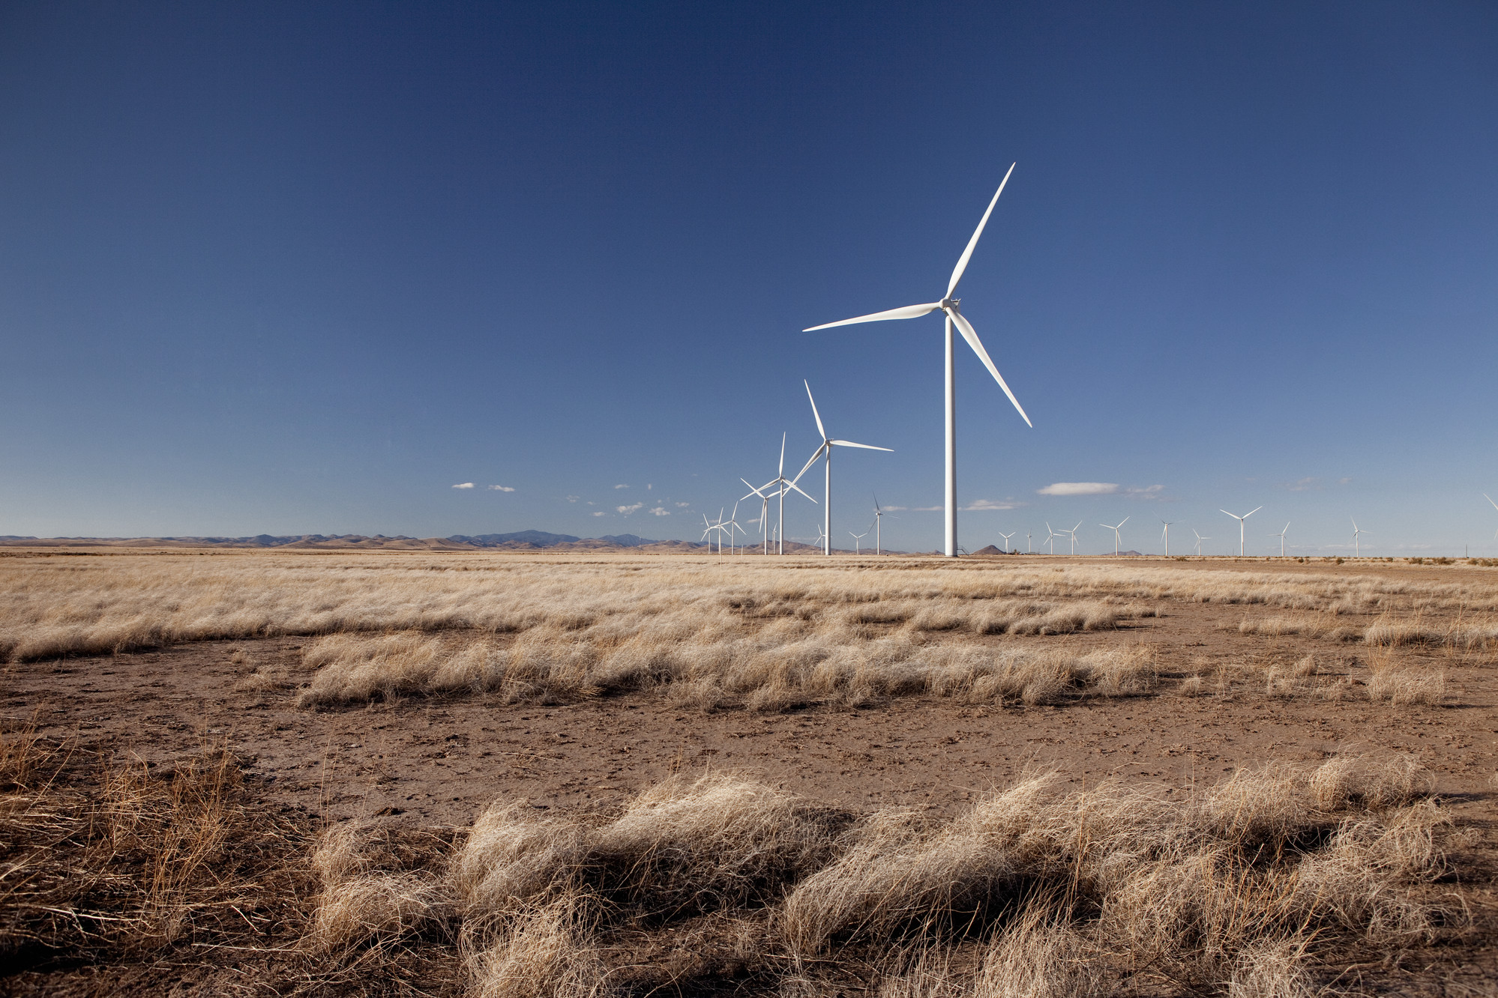
Implementation
Notes:
Country: USA.State: New Mexico.Site: Macho Springs.Turbine: V100 1.8 MW

Slide 14
Assessments
10 certification bodies
21 test laboratories
First test lab assessment in two weeks
Certification body assessments will start in a few weeks
Assessment procedure is designed & expected to reduce difference in interpretation of the standard as well as check for proper application of the standards

Slide 15
Global quality level
Both OEMs and EndUsers have shared concerns about the lack of a global quality level for test labs:
Unclear standards, multiple interpretations possible
No ‘fast’ process to reduce/remove these differences
Accredition focusses more on organisation and quality system than on compliance and technical understanding.
Variation in approach between accreditation bodies
Undue commercial influence
Lack of alignment in reporting (e.g. reporting template required for global use)

Slide 16
Fast track alignment
Proficiency testing – deviation found
Mistake or unclear wording
mistake
Unclear wording
WG551 (Test Labs) issues a clarification sheet for the standard
TL corrects mistake and submits new results
Maintenance team under TC88 includes all clarification sheets in the next revision of the standard

Slide 17
Thank You

